Slide 1
Patient Compliance
Priti Patel

Slide 2
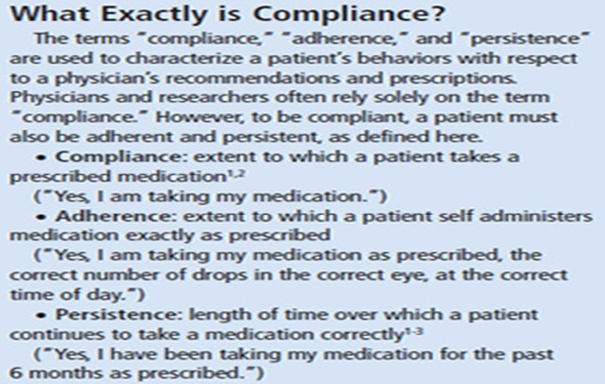

Slide 3
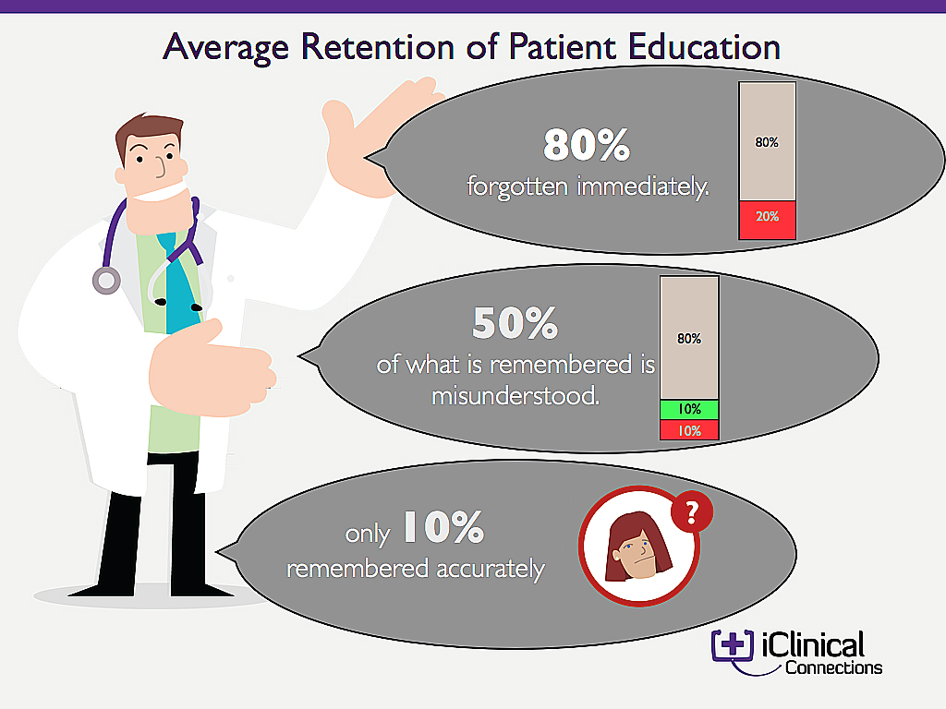

Slide 4
Compliance is defined as “adherence to a prescribed therapeutic regimen” because of a perceived self-benefit and a positive outcome.
Patient compliance describes the degree to which a patient correctly follows medical advice.
Most commonly, it refers to medication or drug compliance, but it can also apply to other situations such as medical device use, self care, self-directed exercises, or therapy sessions

Slide 5
Noncompliance : patient does not follow the treatment schedule suggested by the physician for the management of illness.
It also encompasses failure to obey instructions on other aspects of health care, such as
Diet
Exercise
Smoking and drinking habits etc

Slide 6
Degree of non-compliance is expressed as a percentage of the deal compliance
% compliance = [(NDP-NME) / NDP] * 100
NDP = number of doses prescribed
NME = number of medication errors
Any arbitrary value less than 90% indicates suboptimal use of medication

Slide 7
Adherence vs compliance
Compliance suggests a process in which dutiful patients passively follow the advice of their physicians.
Adherence suggests how most of the patients actively participate in their care and decide themselves when and whether to follow their doctor’s advice.

Slide 8
When is Adherence important?
Replacement therapy – insulin, thyroxine
Asymptomatic patients / Maintenance of pharmacological effect – antihypertensive drugs
Maintenance of serum drug concentration to control a particular disorder – anticonvulsants
To control diseases of public health – HIV, TB
In chronic, progressive diseases
Contraceptive pills
Overdose which causes serious health hazards

Slide 9
Conditions necessary for adherence : The patient must -
Understand and believe the diagnosis
Be interested in their health
Correctly assess the impact of the diagnosis
Believe in the efficacy of the prescribed treatment

Slide 10
Factors that influence compliance with the therapy -

Slide 11
1. Disease –
Chronicity and severity of the disease and presence or absence of complications
For example, in a patient with a chronic disease with few or no symptoms, adherence to a certain regimen is very poor.
Attitude towards the disease and acceptance of the sick role
Mental disorders and severely disabling diseases interfere with the ability to comply

Slide 12
2. Therapeutic regimen -
Longer and more frequent administration – less patient compliance
Multiple drug therapy and complex treatments that interfere with the daily life
Disabling and intolerable adverse effects
Cost of the therapy

Slide 13
3. Interaction between patient and healthcare professional -
Caring, concerned and supportive healthcare professional will increase the patient compliance
Good communication and counseling and increase in patient’s understanding of the therapy

Slide 14
4. Socio-economic factors -
Age extremes,
lack of material resources,
interference with work schedule and
lack of family support
Old people living alone, with limited finances and requiring multiple drugs

Slide 15
Factors affecting compliance
The primary factors affecting patient compliance fall into one of two groups, which are
1) external influencers, or
2) patient experience.

Slide 16
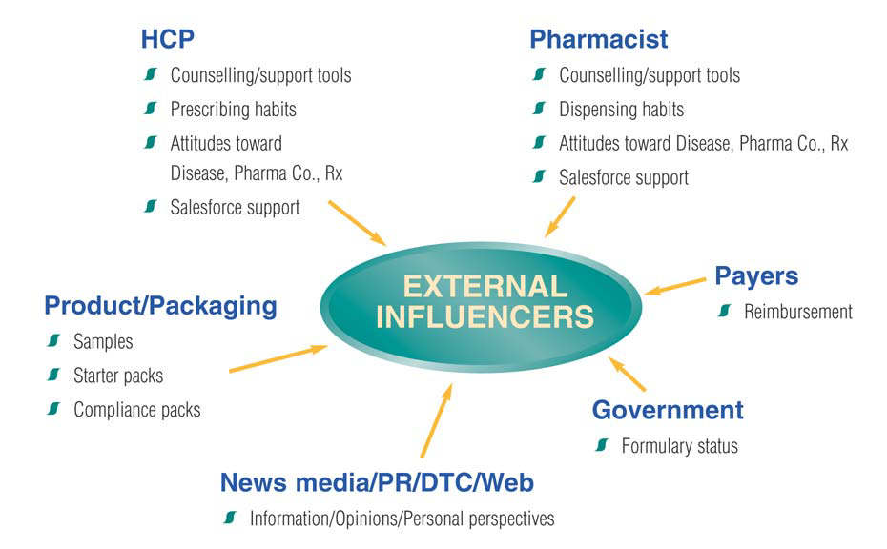

Slide 17
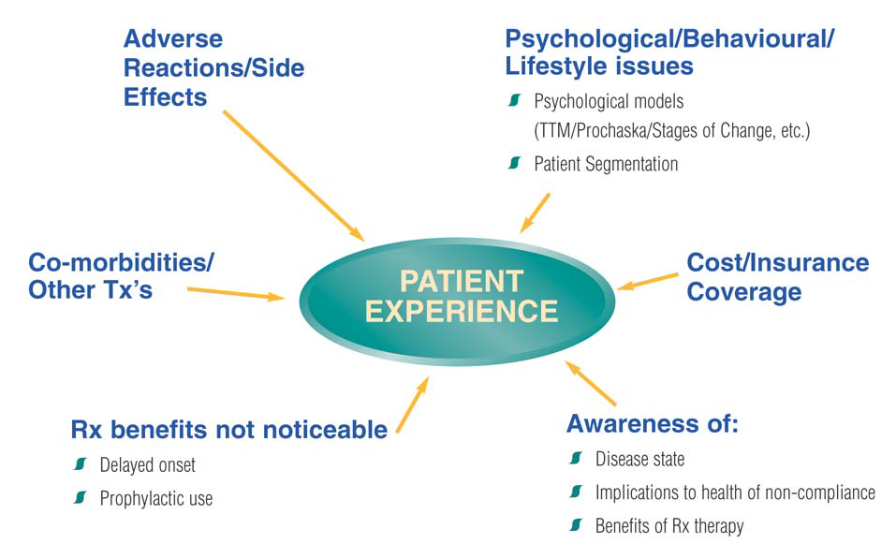

Slide 18
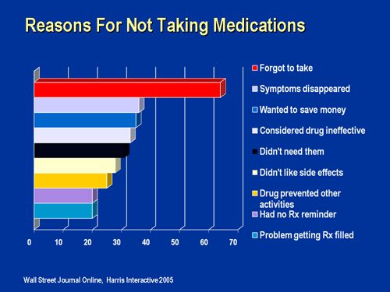

Slide 19
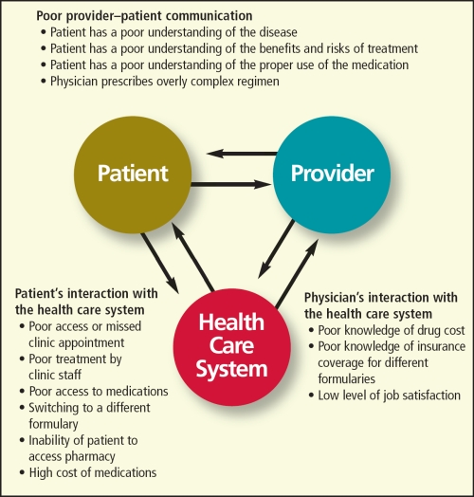
Obstacles to Patient Compliance

Slide 20
Methods to assess patient compliance-

Slide 21
Many ways to evaluate – no “Gold standard” method
Information reported by patients –
orally or in writing –
unreliable due to –
inability to remember or
false reporting
to please or avoid disapproval of the physician

Slide 22
Indirect methods -
1. Interrogation –
Use of standard questionnaires to assess compliance level and
inconvenience of the regimen,
incidence of side effects and
overall level of comprehension
Too subjective – not always reliable

Slide 23
2. Pill count (Residual tablet counting)
At every visit, according to requirements, the patients received a supply sufficient for the interval to the next appointment plus extra tablets for a week. They were asked to return the remaining tablets at the time of the next clinic visit. Compliance was assessed as the percentage of pills prescribed which were taken:
Compliance (%)
=(Number of pills taken)/(Number of pills prescribed )x 100
=(# of tabs prescribed-#of tabs returned)/(# of tabs prescribed)x100

Slide 24
3. MEMS devices –
Medication Event Monitoring System
Standard pill containers with microprocessors to record timing and frequency of bottle openings
Major limitation – opening of the bottle is recorded as an event whether or not patient actually took the drug
At every visit, patient had a MEMS reading, data showed as a calendar plot with information regarding no. of bottle openings each day and exact time when the bottle was opened
Compliance – assessed as ratio of no. of opening to no. of doses prescribed

Slide 25
Direct methods -
1. Drug Analysis –
Specific and sensitive methods of analysis to detect potent agents in body fluids
Bioavailability (F) and clearance (CL) – assumed to remain constant, average steady state concentration (C_{PSS}) for a dose (D) administered at dosage interval (T) is expressed as –
C_{PSS} = (FD)/(CL*T)
Dose input rate is calculated as –
FD/T = C_{PSS}*CL

Slide 26
2. Urine markers –
Urine marker – Riboflavin : added to dosage regimen and its presence in the urine is noted for more accurate assessment of compliance

Slide 27
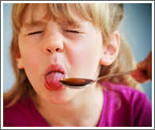
Reasons for noncompliance

Slide 28
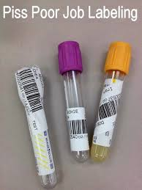
1. Poor standards of labeling -
Labels – must be clear and specific (no ambiguity)
Instructions such as “take as required” or “use as directed” are not specific
Poorly written labels with bad handwriting – major source of medication errors

Slide 29
2. Inappropriate packing -
Elderly patients – difficulty in opening container, specially if size is too small or cap is difficult to twist
Blister pack – too rigid
Glass bottle – fragile
Thus difficulty in handling

Slide 30
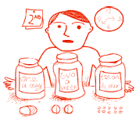
3. Complex Therapeutic Regimen
Difficult to memorize and thus unintentional noncompliance

Slide 31
4. Nature of Medication -
Unpleasant taste, color or odor – noncompliance within patients (particularly children)
Extremely small tablets – difficult to handle or identify
Large tablets – difficult to swallow
Occurrence of irritating side effects – precipitate in noncompliance

Slide 32
5. Deliberate deviation -
Some patients believe that once they begin to feel better, treatment may be stopped
Mental frailty – may forget to take occasional dose
Forgetfulness – complete omission of doses or duplication of doses : more common with socially isolated geriatric patients
Lack of proper physician – pharmacist – patient rapport

Slide 33
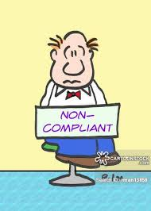
Strategies for improving compliance

Slide 34
1. Simplification of therapeutic regimen
Minimizing the complexity – minimum number of drugs with well defined dosage schedule
Use of sustained release and long acting oral preparations
Single dose drugs (phenytoin, propranolol or antidepressants) promote compliance by reducing adverse effects
Fixed dose combinations for-
Synergism (Cotrimoxazole)
Improved efficacy (oestrogen-progesterone contraceptives)
Reduction in side effects (levodopa and decarboxylase inhibitor)

Slide 35
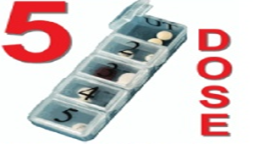
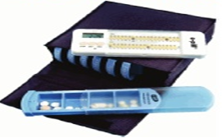
2. Development of suitable medication packing -
Unit dose package – blister pack – encourage degree of self monitoring – improved compliance in intelligent and motivated patients
Medication box – all the different drugs to be taken at a specific time are grouped together in one compartment

Slide 36
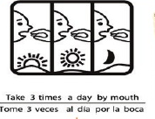
3. Supplementary labeling -
Precautions or recommendations that enhance the advice of the prescriber
Based on potential clinical significance for the benefit of patients
Should be concise, uncomplicated and foolproof
Description of drug action given in lay terminology
Symbols and graphics to emphasize correct time of administration
‘Daily calendar’ or ‘Tablet identification card’ bearing details of administration schedule

Slide 37
4. Patient counseling and education
Pharmacist should inform, educate and counsel patients about following items about each medication in the dosage regimen –
Name (trade name, generic name and common name)
Intended use and expected action
Route, dosage form, dosage and administration schedule

Slide 38
Special directions
Common side effects
Techniques for self-monitoring
Proper storage
Drug-drug or drug-food interactions
Prescription refill information
Action to be taken in event of a missed dose
Selection of OTC drugs and their use

Slide 39
Methods for imparting patient education depend on type and extent of advice needed :
Verbal counseling
Printed information
Warning cards
Medication instruction sheet
Leaflets and booklets describing drugs
Patient package inserts
In-patient medication training programmes
Compliance clinics

Slide 40
Routine counseling is both undesirable and impractical.
Priority should be given to cases where –
Prophylactic treatment is required in absence of symptoms (tuberculosis)
Drugs having low safety margin (warfarin)
Premature withdrawal may have serious consequences (corticosteroids)
Long term therapy for chronic conditions (epilepsy)

Slide 41
Advisory and precautionary instructions
Instructions | Examples of drugs
Do not take aspirin with this medication | Warfarin
Take medication with plenty of water | All sulpha drugs
Don’t drink milk while taking this medication | Tetracycline
Take medication with milk | Iodine preparations
Avoid contact with skin and clothing | Non staining iodine ointment
Avoid contact with teeth, use straw to drink | Syrup of ferrous iodide

Slide 42
Avoid undue exposure to sunlight | Sulphasalazine
Shake well before use | Oral emulsions and suspensions
Take medication on empty stomach | Penicillin, cloxacillin
Take medication half an hour before meal | Ampicillin, erythromycin
Take with meals | Reserpine, Tolbutamide
Take after meals | Isoniazid, hydrocortisone
Medication may colour the urine | Rifampicin
Complete the course of treatment unless otherwise directed | Antibiotics

Slide 43
Instructions for specific dosage forms
Dosage form | Instruction
Oral liquids | Shake well before use Use standard measuring device for uniform dosage Store in cool and dark place Replace the cap tightly after use Expiry date
Capsules | To be swallowed whole without breaking the shell To be swallowed with full glass of water Hot drinks could affect timed release capsules
Tablets | Store in cool and dry place Sublingual tablets – place below the tongue Chewable tablets – to be chewed, not to be crushed or swallowed

Slide 44
Eye and ear drops | Method of inserting without touching head Explain position of head while administering eye drops Importance of keeping the dropper clean and sterile Use may cause temporary discomfort
Injections | Watch for infiltration or oozing of medication from injection site If there is localized swelling, pain or inflammation at injection site, inform physician
Inhalation aerosole | Check the mouth piece and actuator for cleanliness Shake the inhaler vigorously before action Hold you breath for few seconds, before breathing out slowly

Slide 45
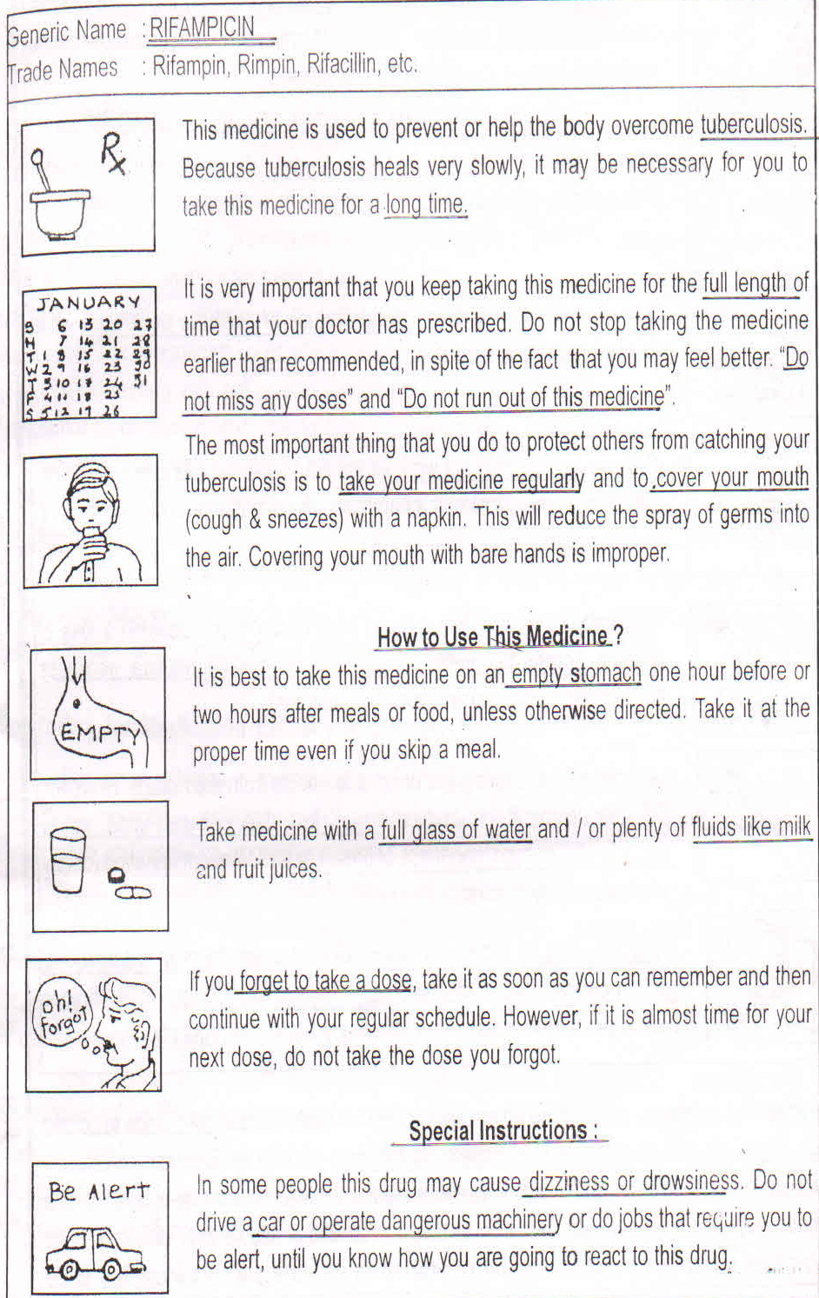
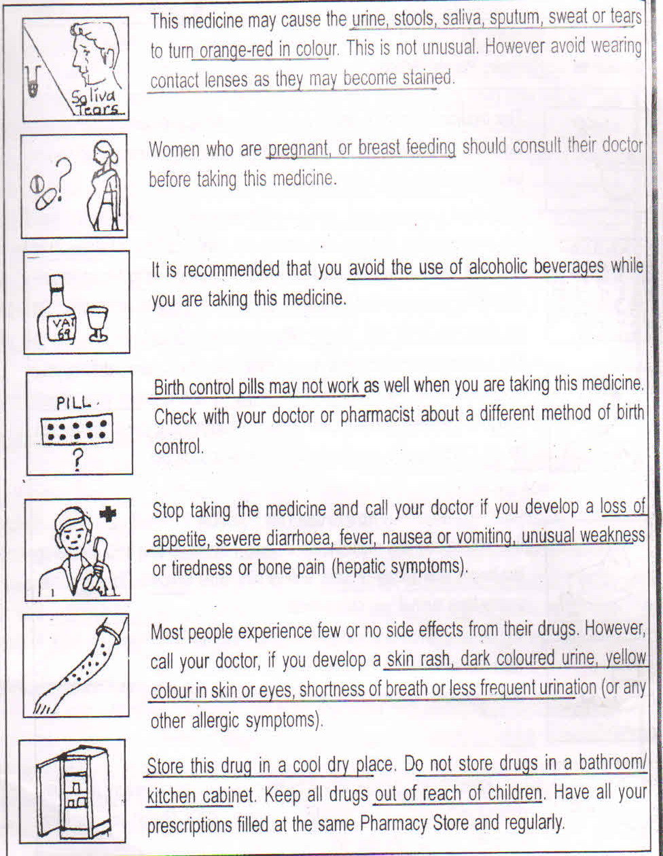
Drug information sheet for patient counseling

Slide 46
Overall rates of noncompliance
90% of elderly patients make some medication errors
35% of elderly patients make potentially serious medication errors
75% of chronic care patients prescribed drugs either stop taking their medication at some point or don’t take them as directed
Only 75% of the patients who understand and agree with the treatment are compliant

Slide 47
Health effects of noncompliance –
Increased morbidity
Treatment failure
Exacerbation of disease
Increase in frequency of physician visit
Increased hospitalization
Death

Slide 48


